Slide 1
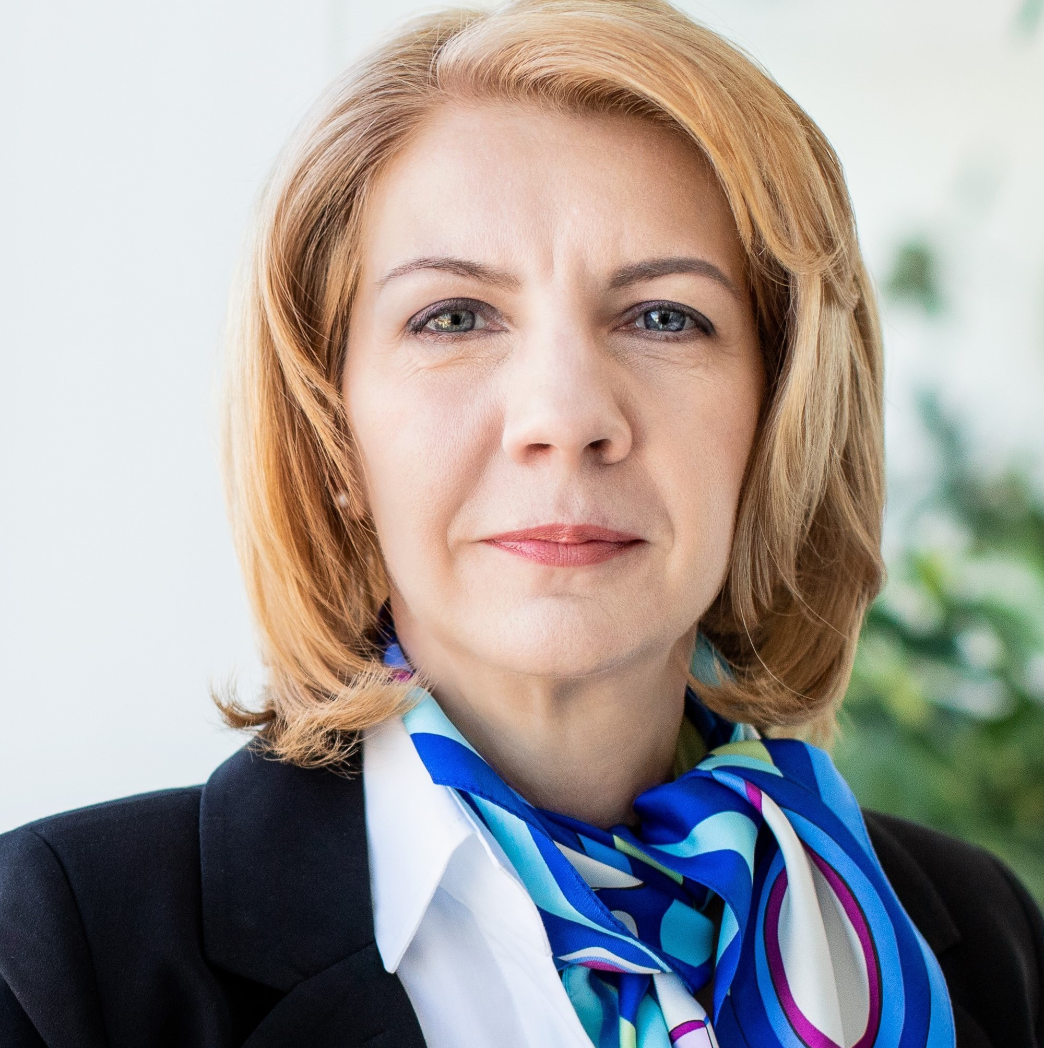
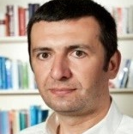
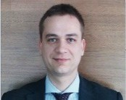
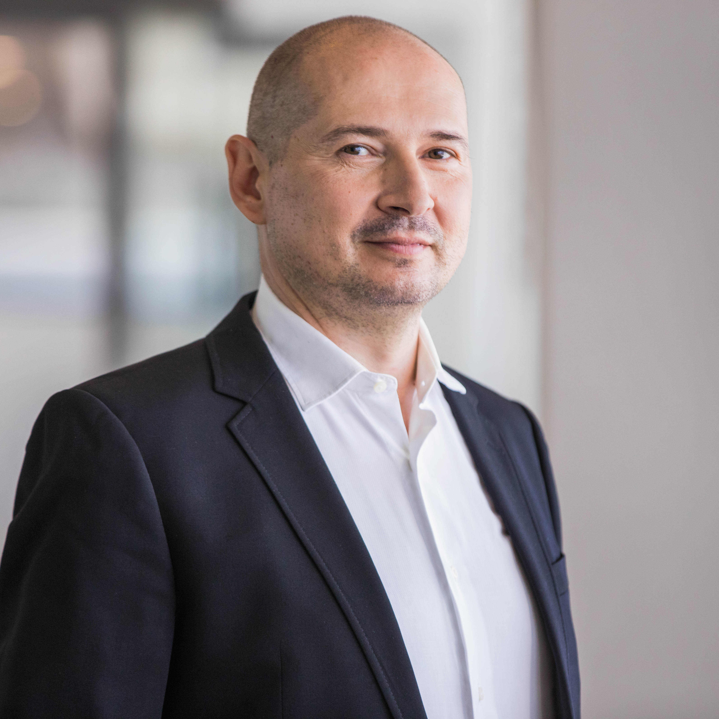
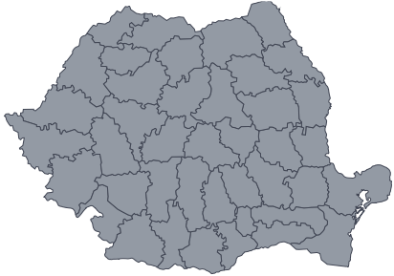
Highly experienced and dedicated team
_{What EY brings}
EY | Assurance | Tax | Transactions | Advisory
• Partners team with 100+ years cumulated experience
Florin Vasilică
Partner
EY Romania
Strategy and Transactions
on the transactions market
+25 years
About EY
• Broad experience in mergers and acquisitions,
of experience
EY is a global leader in assurance, tax, transaction and
advisory services. The insights and quality services we
deliver help build trust and confidence in the capital
markets and in economies the world over. We develop
outstanding leaders who team to deliver on our promises
to all of our stakeholders. In so doing, we play a critical
role in building a better working world for our people, for
our clients and for our communities.
disposals, due diligence, financing, business modelling and valuation, real estate, restructuring, technology related services
SaT Leader
Mergers & Acquisitions
CESA Capital & Debt Advisory
EY refers to the global organization and/or one or more
Liliana Bușoiu
Associate Partner
+23 years of experience
Ileanu Gutu
Associate Partner
+14 years of experience
Andrei Eftimie
Associate Partner
+16 years of experience
Ciprian
Nacu
+21 years
of experience
of the member firms of Ernst & Young Global Limited,
each of which is a separate legal entity. Ernst & Young
Global Limited, a UK company limited by guarantee, does
not provide services to clients.
For more information about our organization, please visit
www.ey.com
Transaction Dilligence
Valuation, Modelling & Economics
Capital & Debt Advisory
Restructuring
© 2020 EYGM Limited. All Rights Reserved.
Sebastian Mocanu
Partner
+21 years of experience
Marius Nicolae
Senior Manager
+20 years of experience
Dan Fleșariu
+16 years of experience
Financial Services
Technology
Real Estate
EY offices in Romania
EY Cluj-Napoca
EY Iași
The Office, corp B, 77
United Business Center 3
2nd Block 1st Floor
7D-7E Palas Street, Iași
Iași County, Romania
21 Decembrie 1989 Blvd.
400604 Cluj-Napoca
Satu Mare _{Maramureş}
Botoşani
Cluj County, România
Suceava
Tel: +40-264 598 221
Bihor
Sălaj
Bistrița
Năsăud
Iaşi
Tel: +40-372 390 200
Cluj
Neamţ
Arad
Alba
Mureş
Harghita
Bacău
Vaslui
EY Timișoara
Timiș
Hunedoara
Sibiu
Braşov
Covasna
Vrancea
Galaţi
EY Bucharest
City Business Center
Caraș-Severin
Buzău
Brăila
Tower Center, 22nd Floor
15-17 Ion Mihalache Blvd.
Sector 1, 011171 Bucharest
Tel: +40-21 402 4000
E-mail: office@ro.ey.com
Web site: ey.eyromania.ro
10 Coriolan Brediceanu Street
Building E, 2nd floor
_{Gorj} Vâlcea_{Argeş}
Prahova
Tulcea
300011 Timișoara
Mehedinţi
Dâmboviţa
Ilfov
Ialomiţa
Timiș County, România
Dolj ^{Olt}
Giurgiu
Călăraşi
Constanţa
Tel: +40-256 499 742
Teleorman

Slide 2
A Global Network of Transaction Experts with
access to reputable investors
EY Romania
Differentiation in Transaction Advisory
In 1992, we have established our presence on the Romanian market and opened
offices in four locations: Bucharest, Iasi, Timisoara and Cluj-Napoca.
EY Romania – Quick Facts
EY’s capabilities in Transaction Advisory comprise a unique, globally integrated and multi-disciplinary set of services that are much
broader than those offered by Boutique M&A Advisors, Investment Banks and Commercial Banks.
Network with over 14,000 Transaction Experts in over 80
Countries of which over 5,600 Transaction Experts in Europe
Our personnel comprise auditors, fiscal experts, advisors, lawyers and transaction
specialists which allows us to assemble integrated multi-disciplinary teams in
• 29 years of experience in the local market
• Serve c. 54% of Top 300 companies
order to solve the most complex problems your company may be facing.
Geographies Sectors Relationships Services
• Seamless cross service line solutions – ‘best team’ approach: our
team will consist of multidisciplinary experts in transactions which
• ^{14,000 experts worldwide}
We have a tailored approach to each sector we address, with key insights in areas
such as: financial services, oil and gas, energy and utilities, public administration,
technology, real estate, consumer goods, telecommunication, automotive, life sciences, industrial production
operating in Romania by turnover
• Serve c. 25% of insurance companies and
Regional on
the Ground
Global
reach
Complete
coverage
Small &
Medium Size
Enterprises
Large
Multinational
Corporates
Buy/
Sell—side
M&A
execution
Capital
Valuation
Business
Modelling
Due
Diligence
Legal
Advisory
Tax
Planning &
Structuring
is supported by local professionals, ready to realize projects in the
most effective way
• EY is represented in 31 countries (62 offices) across Central and
c. 25% of banks operating in Romania
• Assisted in many major transactions in
& Debt
Advisory
(FDD, CDD,
VDD)
Southeastern Europe & Central Asia
Romania
Our portfolio of services
• We have a digital transformation team
Asia
^{Canada} 1,650+
assisting companies with innovative
solutions
340+
Europe
5,600+
Assurance Services
Tax Advisory &
Compliance Services
Our portfolio comprises over
700+ companies.
Boutique M&A
Advisor
USA
2,400+
India
1,000+
We cooperate with important
government and regulatory
organizations.
Consulting Services
Strategy and Transactions
Services
Investment
Bank
Mexico, Central & South
America and Caribbean
800+
Middle East,
Africa
Legal Services
Clients include national companies
and major foreign investors operating
in Romania
500+
Commercial
Bank
Oceania
750+
CESA region –1,200 SaT professionals
One Stop Shop Transactions
Strategy and Transactions services provided by EY
RO
2
50
M&A Advisory
Capital and Debt Advisory
Valuation, Modeling and Economics
Transaction Support
AL
5
+ + + + + =
AM
6
EY’s
Mergers, acquisitions, disposals, management buyouts, buy-ins, fundraisings
Takeovers and strategic reviews
Corporate strategy assessment
Business portfolio review
Business models and forecasts
Company valuations
Feasibility analyses
Structuring and negotiating transactions
Developing and drafting bids
Capital structure assessment
and advisory
Fund raising and implementation
Covenant breaches
Debt re-arranging
Negotiating interest rate spreads
Identifying alternative financing sources and partners
Business plan review
Bankability analysis
Advising on short – term requirements and methods of crisis stabilization
Option analysis in financial structures
Business, shares, intangible assets, land and buildings, machinery and equipment, portfolio valuations
Financial reporting valuations including purchase price allocation and impairment testing, revaluations, financial instruments and investment properties
Strategic finance advisory including business planning and forecasting, investment appraisals and feasibility studies
Business modelling
Legal, tax, regulatory valuations
Valuations related to legal disputes
Due Diligence on financial, business, operational, commercial and market aspects (buy side and vendor)
Services for the integration/reorganization
Merger related assistance
Assessment of sustainable earnings and free cash flow
Analysis of key revenue and cost drivers
Analysis of commitments and contingencies and debt - like items
Identification of balance sheet exposures
Assessment of key customers and
suppliers
Advice on price adjustment mechanisms, other SPA clauses
Going concern analysis and distressed due diligence
AZ
24
EY’s
EY’s
Recent
EY’s
One Stop
Shop
Wide access to
the potential
BY
20
EY’s
Greatest
value
BG
20
Fully dedicated
and hands-on
team
Clear
understanding of
your priorities
Vast local
HR
27
transactions
experience
Services
capabilities
targets, buyers,
financing
delivered
CY
97
CZ
4
institutions
EE
8
GE
115
RU
GR
24
All transaction related services under one umbrella:
EY’s Strategy and Transactions Services wins:
HU
51
EE
KZ
14
LT^{LV}
M&A Financial Adviser of the Year
2020
LV
BY
LT
10
37
PL
Strategy
MT
137
^{CZ}SK ^{UA} KZ
PL
329
SI
^{HU}RO
MD
Mergers & Acquistions
RU
HR
Strategy & Restructuring
Technology related services
Real estate
RS
38
MT
_{A}^{R}_{L}^{S}BG
GR
GE
SK
16
_{TR AZ} UZKG
Capital and Debt Advisory
Valuation, Business Modelling & Economics
Transaction Diligence
Turnaround & Restructuring Strategy
International Corporate Tax Advisory
Transaction Tax Advisory
Strategy:
Corporate and growth strategy
Transaction strategy
Restructuring and Turnaround strategy:
Credit advisory services: Liquidation Analysis, Entity Priority Analysis, Business & Strategic Reviews (IBR), Assessment and mitigation of short-term cash flow requirements, Critical appraisal of corporate strategy, Review of recent and forecast financial performance and cash flows
Distressed corporate advisory: Crisis Management and Financial Restructuring, Assistance with Business Closure/ Downsizing, Short-term cash flow Advisory, Accelerated disposals and acquisitions
Working capital services
Turnaround - Financial and Operational Restructuring
Corporate and BU IT strategy
IT Portfolio strategy
New market entry opportunities
Digital Strategy and Innovation
Go-to-market strategy
Operational and IT diligence
Commercial diligence (buy-side) /Vendor due diligence (sell-side)
Integration strategy planning and execution
Operational and IT separation
Capital structure review & recommendations
Assessment of financing options; Transaction structuring; Fundraising from various sources of capital; Support in negotiating attractive financing terms
Portfolio assessment: valuation, market match, performance analysis, diagnosis
Optimization options: divestment advice, reconversion options, diversification alternatives, acquisition policies
Capital structure optimization, portfolio refinancing
Cost analysis, financial modelling, cost optimization
Asset sale: vendor’s due diligence, identification of buyers, transaction structuring, transaction assistance
Asset acquisition: identification of suitable targets, seller’s approach, due diligence, transaction structuring, transaction assistance
SI
14
104
One Stop Shop
TR
42
UA
6
UZ
Since 2014, EY joined forces with Parthenon. Thus, we have combined our global reach and implementation experience with Parthenon’s strategy expertise to increase the added value offered to our customers
Global
Private Equity service
2019
No. 1 Financial Advisor by Deal Count
2020

