Slide 1


1
Notes:
We think the answer is simple: Success is Simply Human

Slide 2
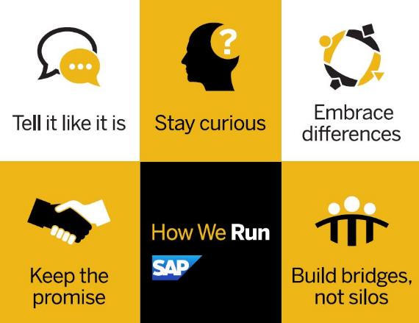
How We Run
Notes:
Introduction:
THIS is How We Run. It’s real, open and authentically SAP.
Tell it Like it Is
Stay Curious
Embrace Differences
Keep the Promise
Build Bridges, Not Silos
Main points:
This initiative didn’t stop at defining How We Run, we equally focused on how these behaviors were to be lived.
When you hear these what kind of company comes to mind for you? (Pause for chances to get some feedback and participation in person or virtually)
Transition:
Involving all levels of employees globally allowed us to collaborate to define SAP’s Run Simple culture – the SAP we are today and the SAP we have yet to become.

Slide 3

The dynamics of engaging people are changing …
Evolving
Workforce
Workplace Complexity
Battle for Talent
Notes:
There is a tremendous amount of change going on in the world around us – change that is happening faster and faster – and it is impacting HR strategies dramatically.
Today’s workforce is more diverse than ever.
For the first time in history we have five different generations of workers working side by side, each with potentially different needs and expectations.
And it’s no longer just about Millennials – who will represent 75% of the workforce in 2025 – but now “digital natives” who have never known life without an internet.
This workforce is also global, and more diverse by gender and ethnicity, providing a new dynamic of culture, language, and views that must also be accommodated.
Finally, the workforce is highly connected and technology-savvy, and use mobility and collaboration tools to share information with co-workers, peers, and partners quickly in an effort to get their jobs done better.
Growing complexity in HR
Unlike Financials, which is heavily governed by public accounting standards, HR has little process standardization (with the exception of regulatory reporting). In many cases, HR has had to “make it up” as they go, often with the unintended consequence of introducing complexity into the operating environment. Old ways of doing things got entrenched and the ability to be agile and flexible became more and more limited. Perpetuating the problem is HR technology. HR systems, often implemented quickly and as part of larger ERP implementations, often didn’t get sufficient budget or resources necessary to rethink processes and eliminate complexity. The result: new technology with heavily customized processes that reflect policies and strategies 20 years old or more. And heavily customized systems can’t be easily upgraded and get frozen in time, so people are using interfaces designed in the ‘90s.
War for talent
While this term, first introduced by McKinsey, has been around the talent management space for almost 20 years now, it has never been more current than today. Why? New research suggests that by 2020, the world could have 40 million too few college-educated workers. Add the fact that Millennials become the largest cohort in the workforce, the basis of competition has fundamentally shifted. Hence the need for a renewed emphasis on and new ways of recruiting, onboarding and retaining top talent.

Slide 4
Mastering these challenges requires a digital approach to HR
HCM technology must encompass a new set of digital capabilities
Continuous
Intelligent
Extensible
    Encourage continuous usage and engagement, and foster continuous innovation
    Use data to suggest and recommend
    Expand solutions and build own apps to meet current and future needs
Across the total workforce
Notes:
We are in the era of digital business and there is no going backward. Disruption and the business opportunities it brings are everywhere. The HCM technology underpinning
Continuous
Today’s systems must be an ongoing destination for employees that encourages continual usage. It is used to help them manage their work, plan their careers, develop new skills, and support changes in their personal lives – all on an ongoing basis. What good is an HR system investment if employees only use it sporadically twice a year – and when forced.
Today’s systems must provide a personalized experience. They must be able to recognize – and cater to – different needs and expectations across a multi-cultural and multi-generational workforce. They need to be flexible enough to deliver processes based on who the individual is, what they do, and how they prefer to interact.
Intelligent
Today’s systems must transform data across multiple sources – HR, ERP, external networks, machine data – into actionable insight to plan, measure, and predict.
Today’s systems must recommend actions based on available data and the experience of others. It’s no longer OK to provide generic information and let the end user sift through hundreds of options, s/he wants an “Amazon” experience: here are some suggestions based on what you bought in the past, what you’ve looked at, and what others like you have bought/looked at.
Extensible
Today’s systems must easily incorporate customer-unique processes into their environments. With HR, one size never fits all: HR often has to support processes because of historical agreements and/or because they help differentiation the organization as employer of choice.
Today’s systems must include a platform and services that enable anyone with an idea to build new innovations and allow customers to easily consume and connect them with their HR systems. The “single data model” for HR is a myth: it always was, it is today, and it will be in the future. Especially today, organizations can’t rely solely on one vendor, it’s too slow: they will wait longer and longer and miss unique ideas that can help them thrive (for example, there are over 2,500 startups in the HR space, many with great ideas that can help companies compete better).
And all of this supporting any kind of worker: permanent, temporary, intern, or alumni.

Slide 5
SuccessFactors Cloud Footprint – 46M+ users, 6,200+ customers
  Performance
  & Goals
  Learning
  Compensation
  Succession & Development
  SAP Jam
43.4million
29.6million
18.2 million
21.2million
42.5 million
  Recruiting
  Onboarding
  Employee Central
  Workforce Analytics & Planning
21.6million
12.0
million
15.1 million
12.3 million

Slide 6

We think the answer is simple …
We think the answer is simple …
6
Notes:
We think the answer is simple: Success is Simply Human

