Slide 1
HealthCare in Romania -challenges and perspectives-
Prof Dr Dorel Săndesc,
Secretary of State, Ministry of HealthCare
President, Romanian Society of Anesthesia and Intensive Care

Slide 2
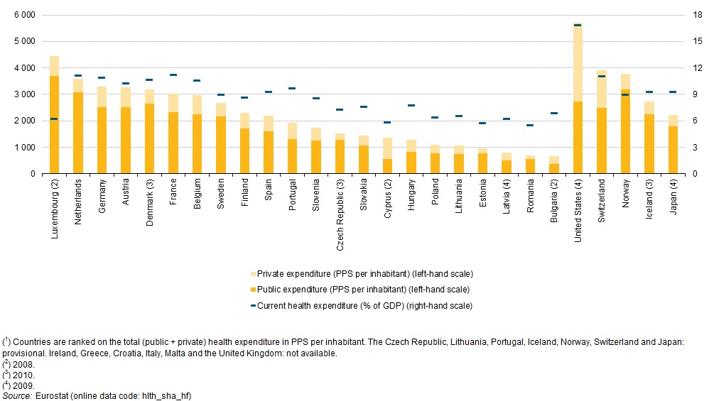
Current healthcare expenditure Eurostat, 2011(PPS: Power Purchase Standard)

Slide 3
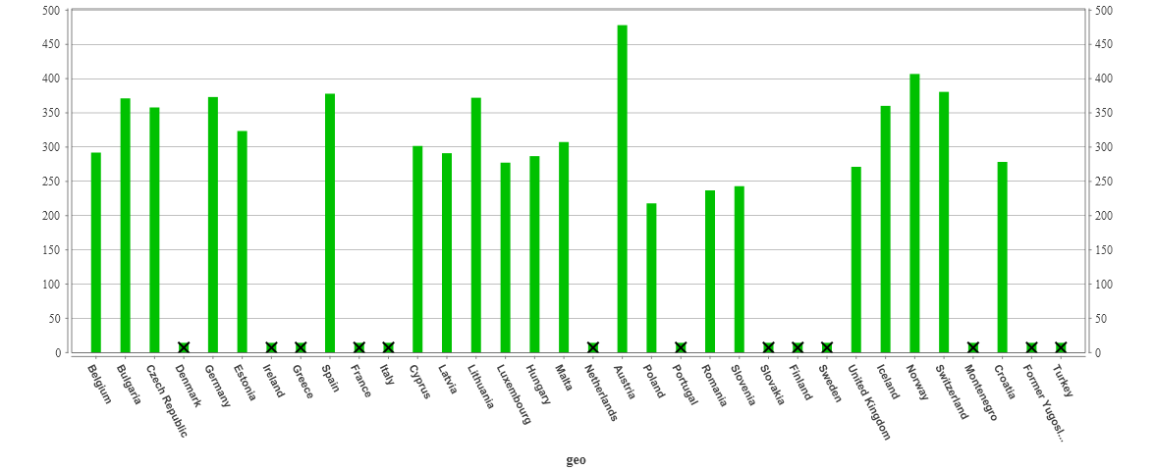
Number of Physicians (Eurostat 2009)

Slide 4
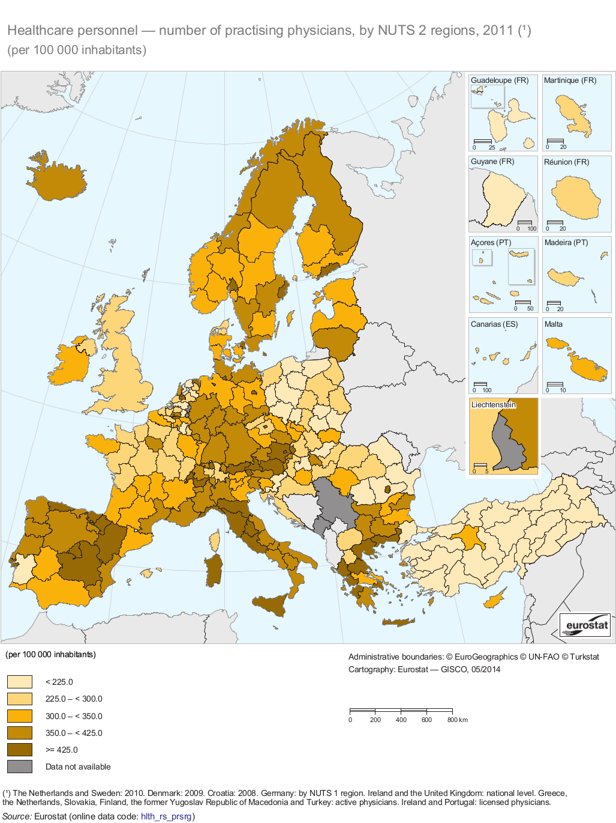
Number of Physicians

Slide 5
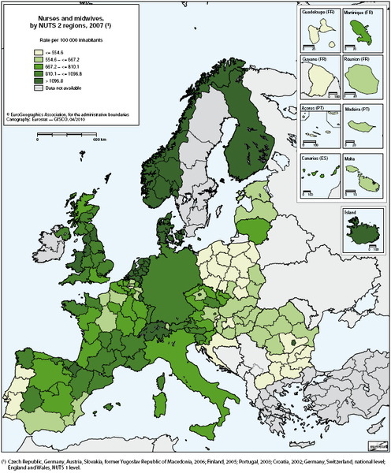
Doctors, Nurses and Midwifes 2009

Slide 6
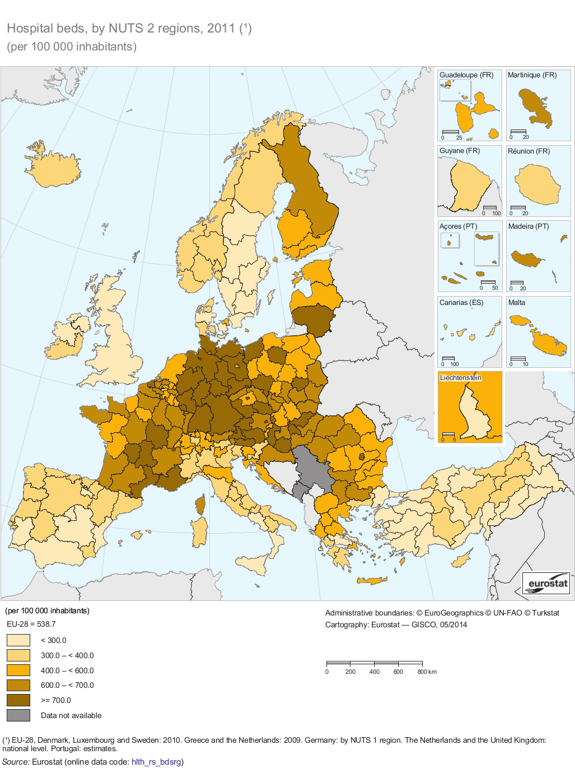
Number of beds, Europe

Slide 7
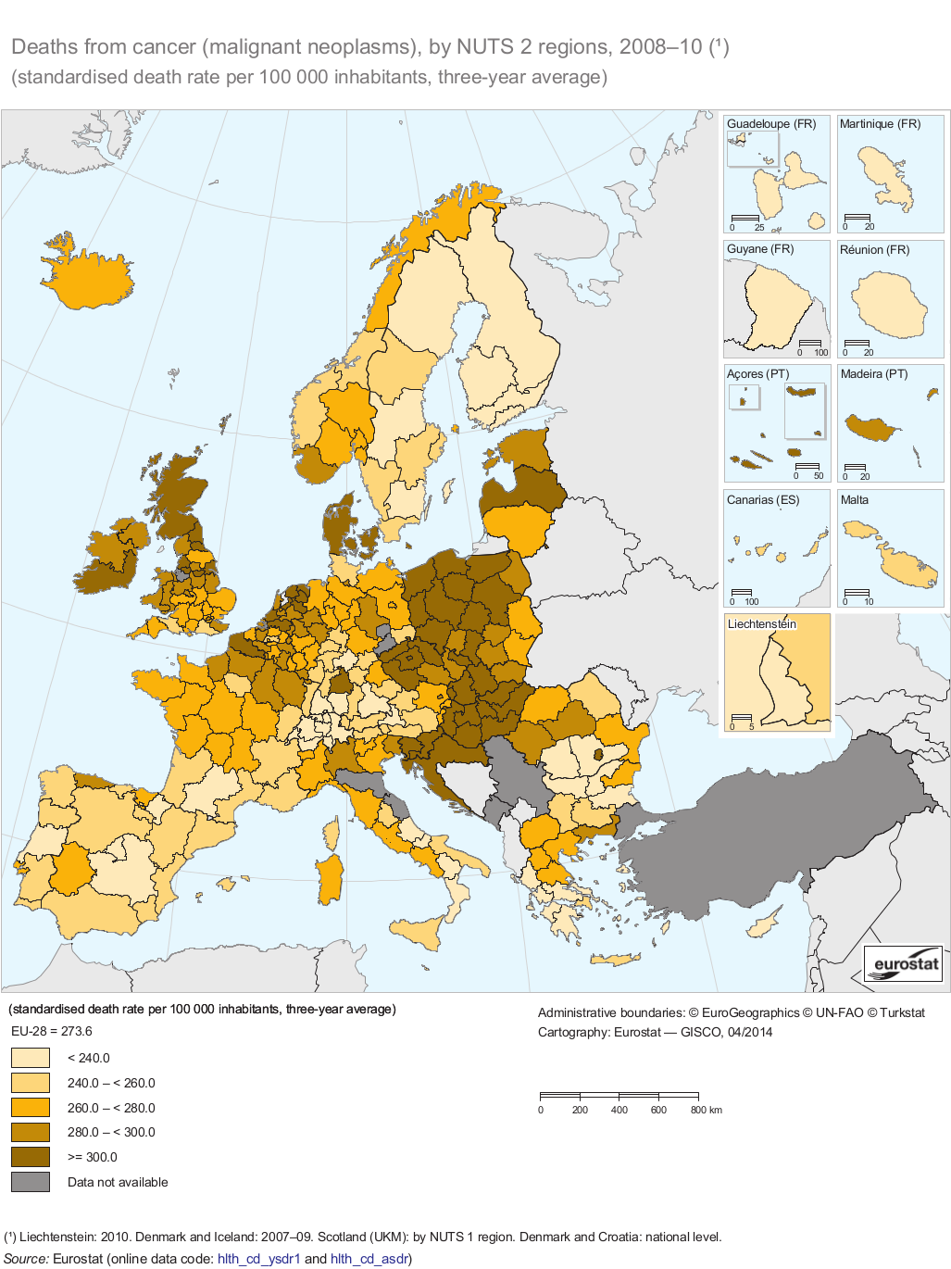
Cancer Mortality, Europe 2010

Slide 8
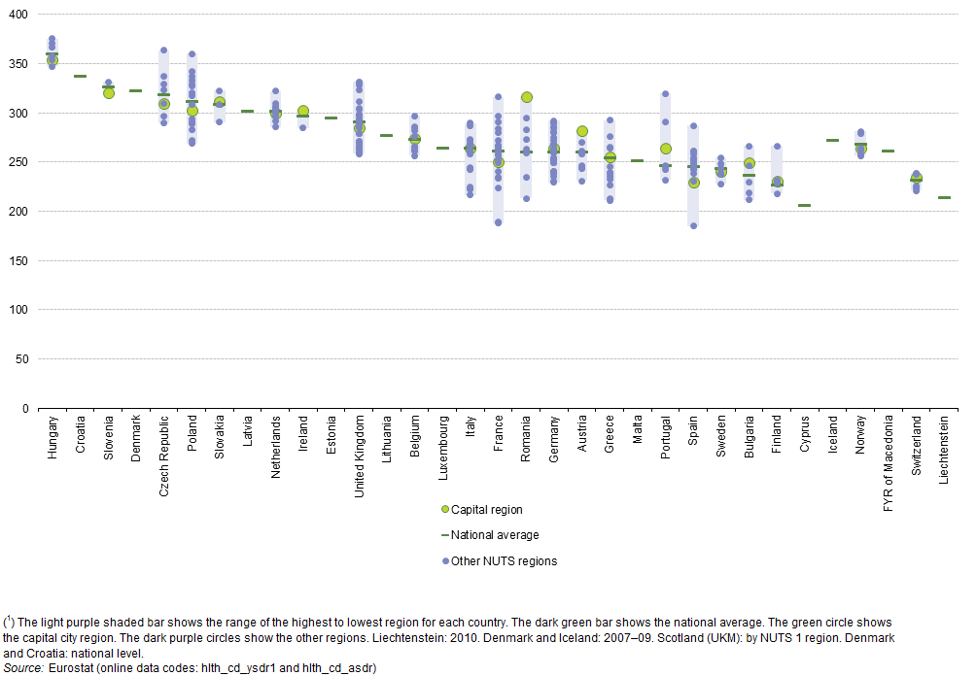
Cancer Mortality, Europe 2010

Slide 9
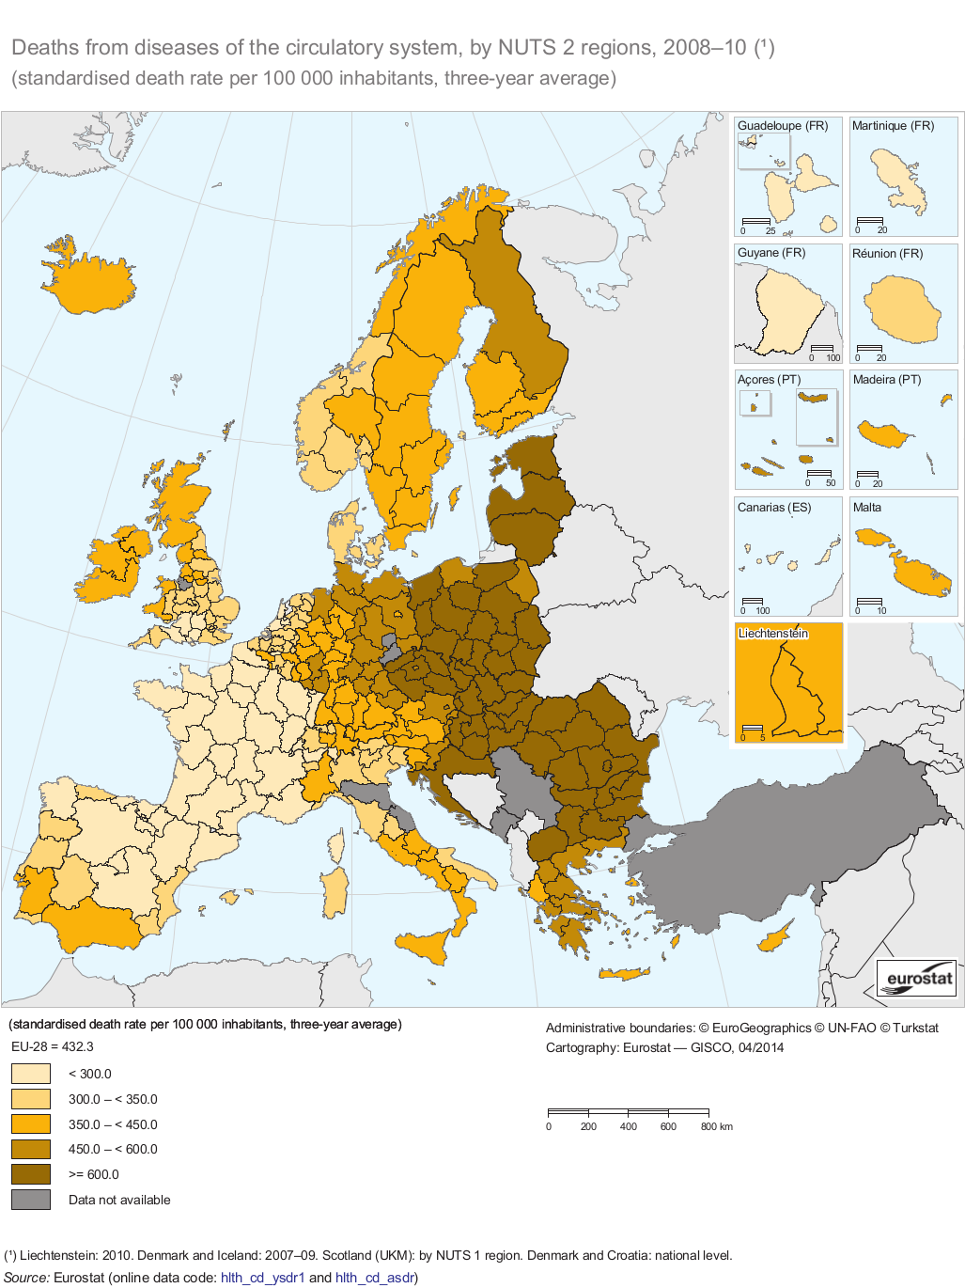
Cardio-vascular mortality, Europe 2010

Slide 10
Situation in 2014
National Programs for Anesthesia&Intensive Care, Acute Myocardial Infarction blocked
Reduction with 40% of the budget for these Programs
Serious threat to delete these programs

Slide 12
April 13th: Main objectives
1. Romanian Integrated, Pre and Intra-Hospital Emergency System
2.Modernisation of Romanian Hospitals, including Anesthesia&Intensive Care Departments (a project with World Bank)
3. Solutions for the development of new, modern hospital infrastructure
4. Solutions for improvement of the Statute of Doctors , Nurses and Medical Staff

Slide 13
Context
A National, Modern, Integrated, Pre and Intra-Hospital Emergency System: a priority
Romania: good, modern, well financed Pre-Hospital Emergency System
In-Hospital: DRG System does NOT cover adequately the real costs of care of critically ill patients

Slide 14
The context
Financing of in-hospital patients: DRG system
DRG: does NOT cover the real costs of care of critically, complex, unpredictable cases (,,cas couteux”, ,,expenses cases”)
Negative impact on important hospitals

Slide 15
The solution: Priority Actions(PA) -a package of National Programs of Health-
PA-Acute Myocardial Infarction: stents
PA-Intensive Care: consumables, drugs, tests
PA-Sudden Death Syndrome: implantable defibrilators
PA-Trauma: osteosynthesis materials
PA-Stroke: -thrombolytics
-consumables for Interventional Neuroradiology
Funds: directed specific to hospitals with the expertise

Slide 16
Priority Actions-Impact PA-AMI Intrahospital Mortality by AMI
Notes:
Sursa: Raport STEMi România 2009-2013

Slide 17
Priority Actions: Impact
PA-Intensive Care: -more than 400.000 patients admitted in ICU’s per year
-significant increase in the quality of care
-international interest in the model(Eastern Europe)
PA-Trauma: -3000 death/year only by road accidents
-reduction of mortality

Slide 18
Priority Actions: New Projects 2015
PA-Endoscopic Treatment of Upper Gastro-Intestinal Bleeding
PA-Endoscopic Treatment of Obstructive Icterus
PA-Endoscopic Treatment of Esophageal Stenosis
PA-Endovascular Surgery

Slide 19
April 13th: Main objectives
1. Romanian Integrated, Pre and Intra-Hospital Emergency System
2.Modernisation of Romanian Hospitals, including Anesthesia&Intensive Care Departments (a project with World Bank)
3. Solutions for the development of new, modern hospital infrastructure
4. Solutions for improvement of the Statute of Doctors , Nurses and Medical Staff

Slide 20
The World Bank Project
-Objective: Reforms and Modernization in HealthCare System
-Technical Assistance for Reforms: Standards of Costs, Development of Day-Care/Ambulatory Services, Development of Complementary Insurance Systems, etc.
-Feasability Studies for 3 Regional Emergency Hospitals
-Modernization of in-hospital key services (top priorities: Anesthesia&ICU, Oncology)
-Anesthesia&ICU: 40 MILLIONS EUROS; starts this year !
-Etc

Slide 21
April 13th: Main objectives
1. Romanian Integrated, Pre and Intra-Hospital Emergency System
2.Modernisation of Romanian Hospitals, including Anesthesia&Intensive Care Departments (a project with World Bank)
3. Solutions for the development of new, modern hospital infrastructure
4. Solutions for improvement of the Statute of Doctors , Nurses and Medical Staff

Slide 22
New hospitals in Romania
An absolute priority
European Funds: do not cover the real needs
3 Regional Emergency Hospitals(with limited financing)
Modernization of County Hospitals
Solutions: a) increase in european funding of medical infrastructure
b)private investments; PPP:
-Full private investment for one Structure(hospital, congress center, apartments for the staff, senior house, school, etc)-300-600 millions Euros
-PPP in management(professional management company)

Slide 23
April 13th: Main objectives
1. Romanian Integrated, Pre and Intra-Hospital Emergency System
2.Modernisation of Romanian Hospitals, including Anesthesia&Intensive Care Departments (a project with World Bank)
3. Solutions for the development of new, modern hospital infrastructure
4. Solutions for improvement of the Statute of Doctors , Nurses and Medical Staff

Slide 24
Projects
Project of Law for regulating the revenues of medical staff in public hospitals and other measures (draft registered in Parliament)
Proposal of Ministerial Order for implementation of the Law for the rights of the patients 46/2003 (in discussion with Patients Associations, Civil Society)
Project: a new system of salaries in the public sector (Government)
Project of SRATI for debate: to stop the activity in public hospitals as employees ; contracts of services between public hospitals and doctors as liberal profession , organized in legal forms(Civil Medical Societies, Patronate of Anesthesiologists, etc.)

Slide 25
MULTUMESC
“Obstacolele sunt acele lucruri
de care ne impiedicam
cand ne luam ochii
de la visele noastre”

